Slide 1
GitHub
Keeping your code organized, backed-up, and easy to transport to any remote computer

Slide 2
What is GitHub?
GitHub is a software system for keeping track of changes you make to a code project.
It is also a place in "the cloud" where you store a safe copy of your code, and from which you can easily distribute your code to a remote machine.
Even if you are only working alone on your own laptop it is valuable to incorporate GitHub into how you work.

Slide 3
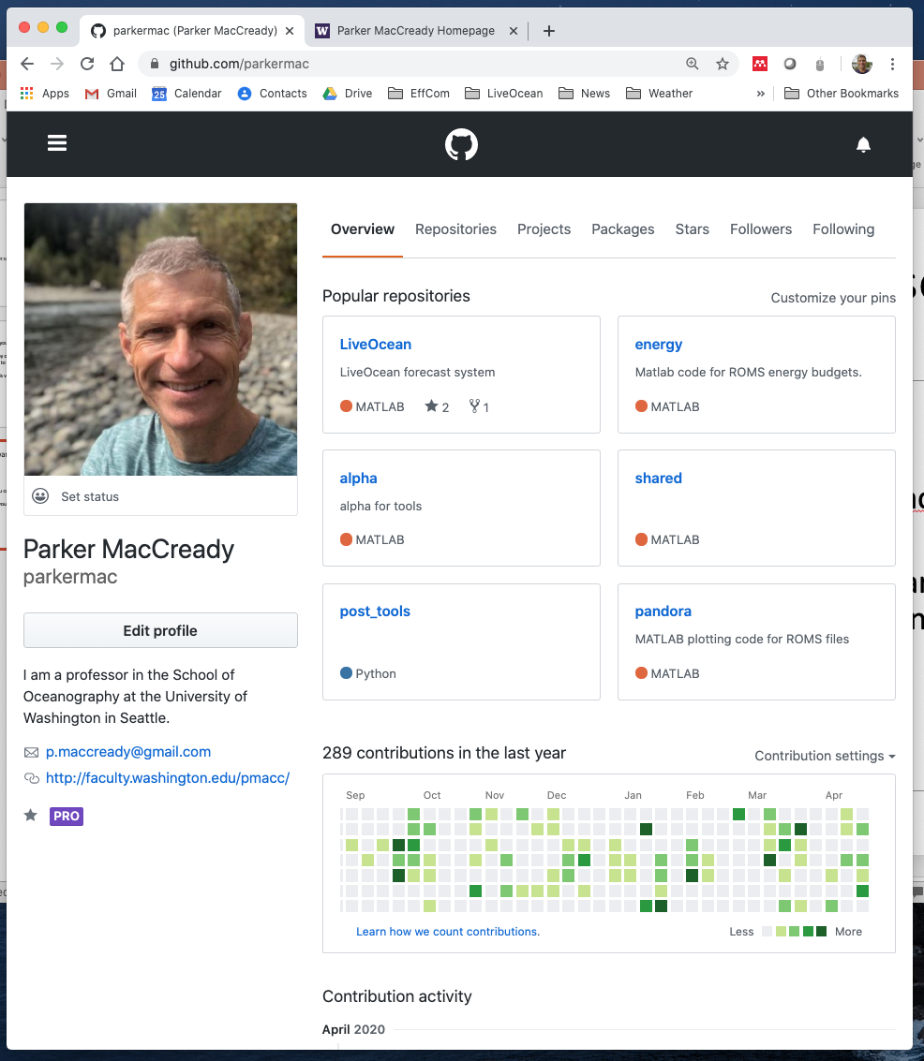
First step: get an account on GitHub
Sign up for a GitHub account:
https://github.com/
You have to make up a username. I use "parkermac". You can add more information to your profile if you like.
It's free!
Note: by default the code on GitHub is publicly available.

Slide 4
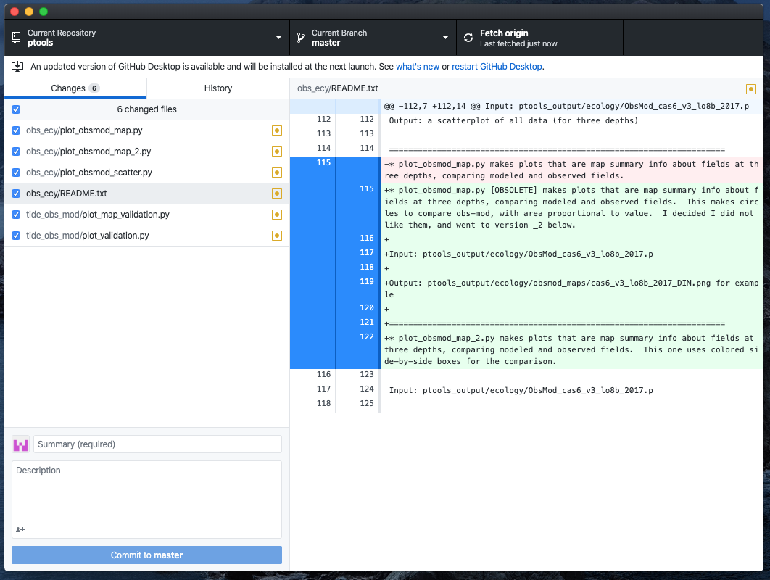

Then get some software for your computer
Download and install the "GitHub Desktop" software on your personal computer, available for both Mac and Windows.
https://desktop.github.com/
It makes this icon,
a purple cat
The app looks like this

Slide 5
Launch GitHub Desktop and...
In GitHub Desktop -> Preferences, log into your GitHub account
In GitHub Desktop also do "Install Command Line Tool..."
(everything you do by clicking in the Desktop app you can also do from the command line, but for now we will stick to using the app).
Now you have all the tools in place, but you still need to put a code project into Git...

Slide 6
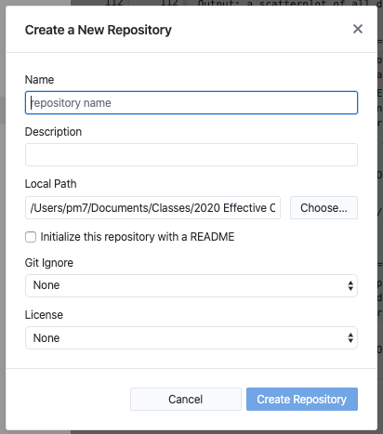
Put your first code project into git
1. Type the name of the existing folder, or the new folder you want to create
Choose a folder that already has some code in it (OK for it to have subfolders - but it should all be code and text files, not data or output), or choose the name of a new folder that you will put code into later.
Launch the GitHub Desktop app on your computer
Do File -> New Repository...
And you will get this box ===>
2. Add some words describing it
3. Use Choose... to navigate to where the folder is, or where you want it to be (the parent directory of the one where you project is). No need to initialize with a README.
4. For Git Ignore choose: Python
5. For License choose: MIT License
6. Then click this!

Slide 7
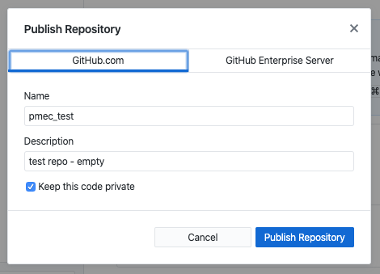
public or private?
When you make a new repo and publish it to GitHub you now can choose to make it public or private
It used to be that you had to pay to make it private - that it no longer the case.
I prefer to keep things public by default, except under circumstances where I really need them to be private.
For this class I'd suggest you make your classwork repo public, so I can see it if needed, but the choice is up to you.
Unclick?

Slide 8
What you did...
You made Git on your computer know that you want it to keep track of the code project in this folder
In that folder it created a hidden directory called .git. That is where is stores information on all the changes you make to code there. You never need to look in this.
I did not suggest adding a README because it just adds an empty file in "Markdown" format. I'd prefer that you write your own README as a text file because it is simpler and more portable.
You added a LICENSE text file that says anyone can use this code
You added a hidden text file called .gitignore that has a long list of file types for which Git will not keep track of changes. One of these would be the ".pyc" files that Python automatically creates for any module you write - it is a compiled version of that module.
If you had any code in the folder to begin with it also automatically "committed" them with the message "Initial commit"

Slide 9
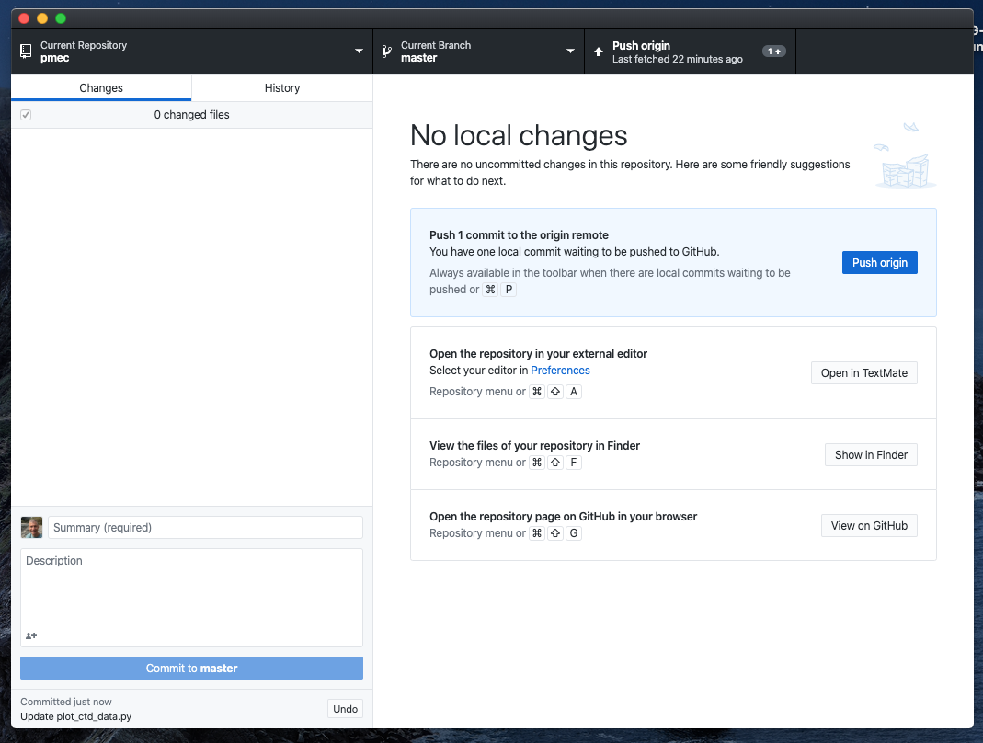
Next you want to push this repository to GitHub in the cloud, using the GitHub Desktop app on your laptop
Make sure you are on the "Changes" tab
(the History tab shows past changes)
Then click on the "Push origin" button to send a copy of your code project to the GitHub cloud
If you need to save any changes locally, you type in a Summary and then commit
You can add more detail in the Description box, but it is not required

Slide 10
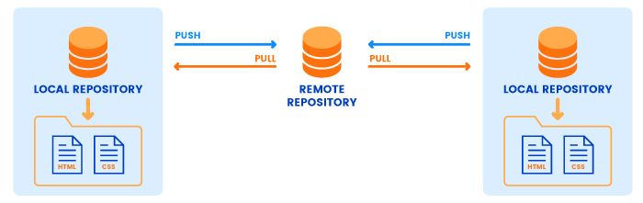
Concepts & Vocabulary
GitHub in the cloud
Copy of code project on remote machine,
like fjord
Code project on your laptop
Your code project is just a folder (and any subfolders) with code and other text files.
When you tell git to make this code project a "Repository" then git adds a hidden folder ".git" to your folder where it keeps a copy of your files and a history of all the changes you make. That is the "Local Repository" in the figure above.
"repo" is the slang for Repository. Use it in casual conversation with friends so they will know you are cool.
Every time you change a file in the folder (add, delete, rename, or edit) git will keep track, and then when you "commit" the changes they will be part of your local repository.
Then you "push" your local repository to the cloud: your GitHub account. Mysteriously this remote repo is always referred to as "origin", even though the code actually originated from your laptop.
Finally you can "clone" the remote repository to any other machine (like fjord) and it will appear as a folder with your code in it. If you want to update the code on the remote machine you just "pull" it from the remote repo by using the command: "git pull". You do this using the linux terminal and you have to have navigated to be inside the folder containing the code project.
We'll go over the details of the clone step in a few slides.
Figure from: https://rubygarage.org/blog/most-basic-git-commands-with-examples

Slide 11
step 3
step 4
GitHub in the cloud
Copy of code project on remote machine
Code project on your laptop
A very simple "one-way" workflow consists of:
edit code on your laptop and save the changes
commit the changes using GitHub Desktop
push the changes to the remote repo using the "Push origin" button in GitHub Desktop
on the remote machine update the code by using "git pull" from the command line
now you can run the code on the remote machine, confident that it is exactly the same as on your laptop. Of course for this to work your code has to be written to work on the remote machine.

Slide 12
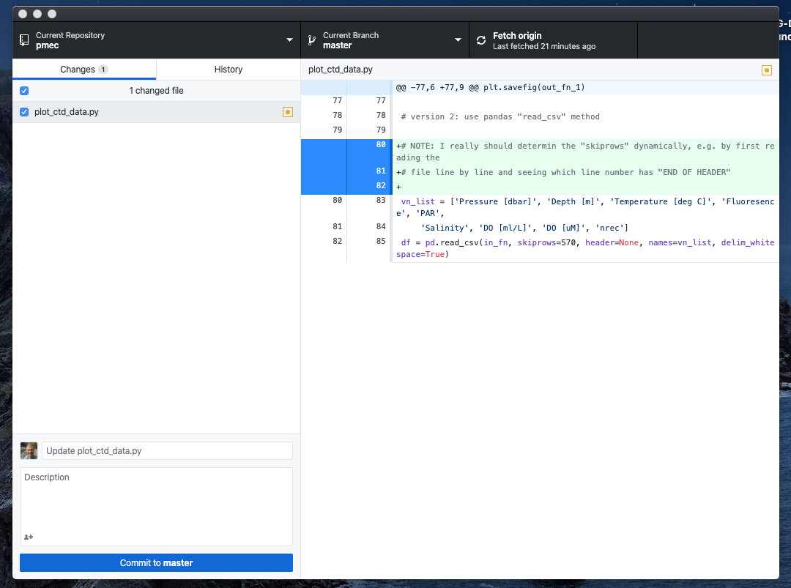
Every time you change a file in the folder (add, delete, rename, or edit) git will keep track
Here is what the app looks like after I made (and saved) an edit to one of my programs in the repo.
Note that in the right panel it shows a focus of exactly what lines changed.
If you feel you are done with making changes in your current editing session (maybe at the end of the day) you:
add a summary of the changes
Click on "Commit to master"
"Click on Push origin"

Slide 13
More git lingo: "master"
The term "master" refers to the "branch" of the repo you are working on. In GitHub you can make other branches, e.g. to test out some new code while you still want the old code to be functional. We will not be using branches in this class, but you may find them useful sometime.
For our purposes, you can just think of "master" as meaning "the version of my code project that has the most recent changes committed".

Slide 14
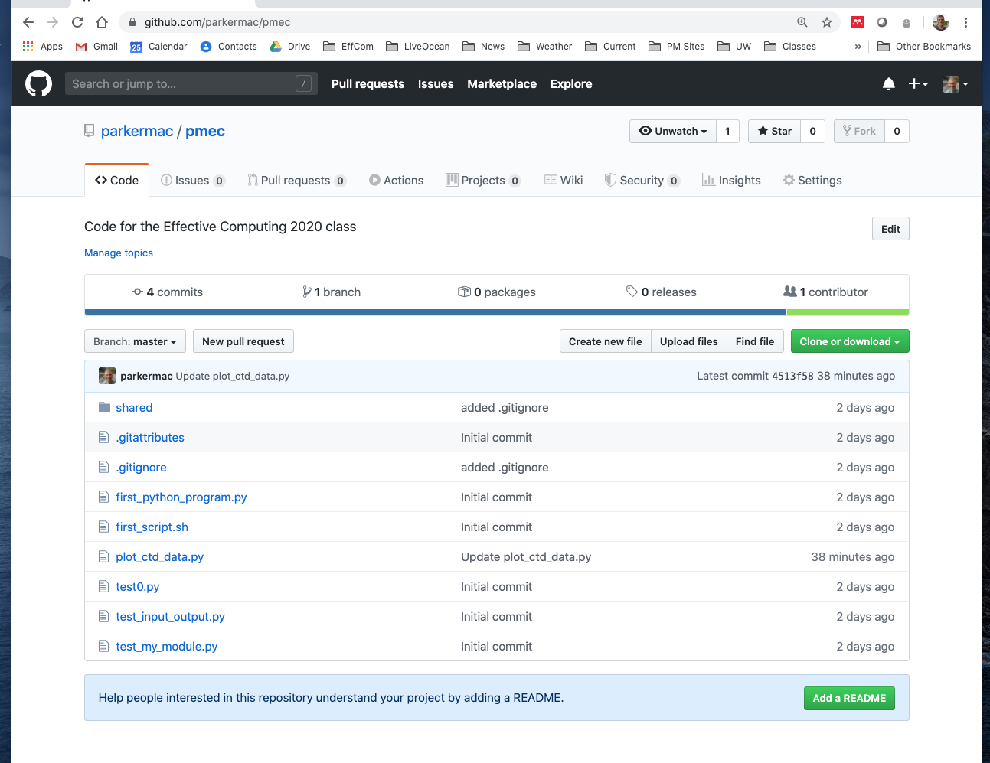
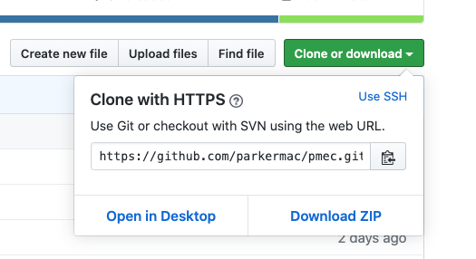
cloning
In order for "git pull" to work on the remote machine you first have to "clone" the repo to that location.
Go to your github.com account and open your repo there
Click on the Clone or download button
Then copy the link it makes by clicking on the clipboard icon

Slide 15
Cloning - last step
Finally, logon to your remote machine (fjord) and cd to where you want the cloned repo to end up - e.g. /data1/effcom/[username]/
and then type:
git clone [paste in the URL you copied]
and your directory will appear, full of your code!
If you make new changes on your laptop, commit and push them, then all you have to do on fjord the next time is type:
git pull
from inside the directory you made, and then code will be updated to the most recent master version.
Note: if you created your repo as private, then you will likely have to issue the command:
unset SSH_ASKPASS
before doing git clone [...]. Then it will ask for your GitHub password.
You can add this as a line in your .bashrc on fjord.

Slide 16
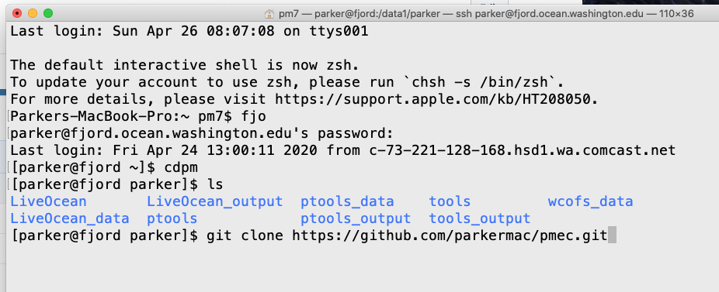
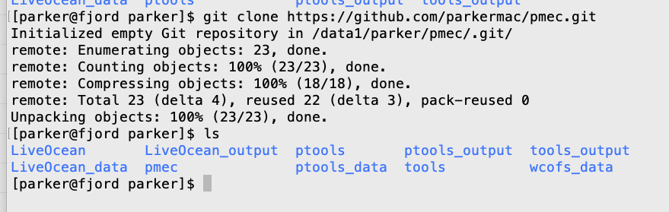
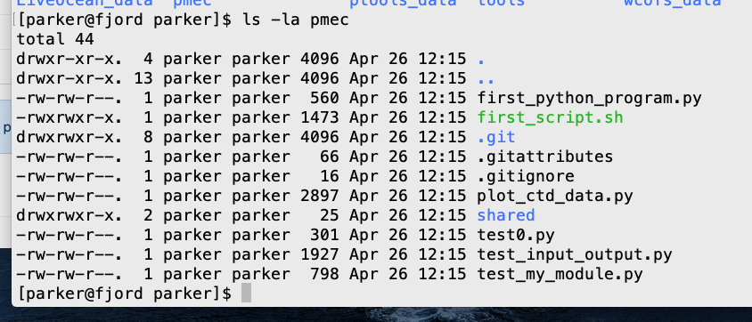
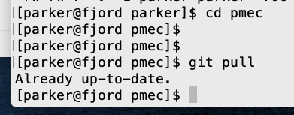
My own cloning screen shots, on fjord:
Note: if you put the repo in the wrong place, just delete it and start again. Git won't mind.
Cloning
When I try to use "git pull" from inside pmec it tells me it is already up to date.
Now the directory "pmec" exists
and pmec has my code in it

Slide 17
Resources
This one is the best Git tutorial I have found, although it does everything from the command line. Nonetheless, very clear on the concepts:
https://rubygarage.org/blog/most-basic-git-commands-with-examples
General advice in installing Git anywhere (e.g. in linux):
https://git-scm.com/book/en/v2/Getting-Started-Installing-Git
Another tutorial from Software Carpentry
http://swcarpentry.github.io/git-novice/
And some thoughts about collaborating using GitHub (which we will get to in the second Git lecture):
https://uoftcoders.github.io/studyGroup/lessons/git/collaboration/lesson/

